Slide 1
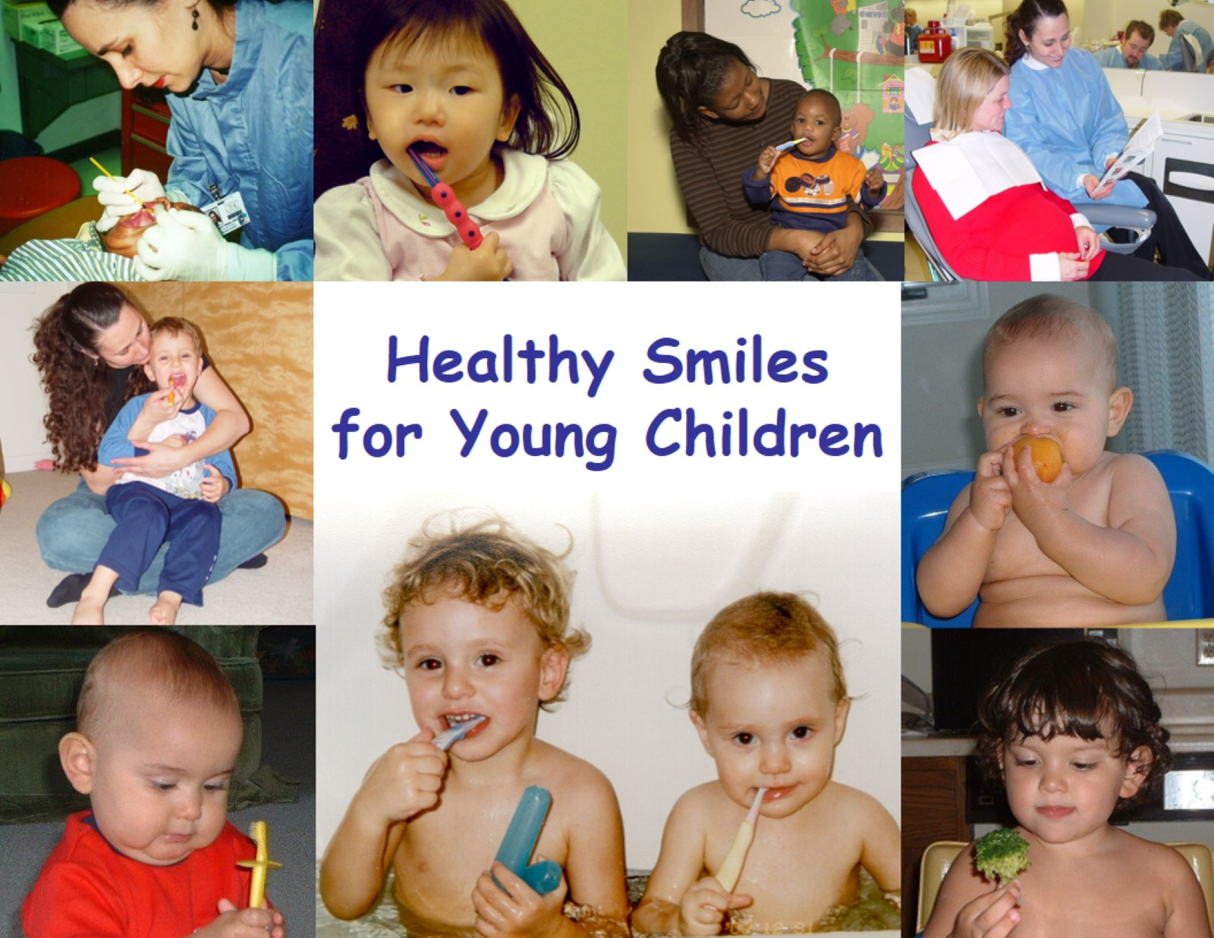
Healthy Smiles for Young Children

Slide 2
Basic Oral Health Care During Pregnancy

Slide 3
When Will My Child’s Teeth Come In?

Slide 4
When Will My Child’s Teeth Come In?

Slide 5
Signs of Teething

Slide 6
Why Are Primary Teeth Important?

Slide 7
Early Childhood Cavities

Slide 8
Cavities can progress quickly

Slide 9
Cavities are Preventable

Slide 10
What Causes Cavities?

Slide 11
Cavities Are Caused By Bacteria

Slide 12
Basic Oral Health Birth to Two Years

Slide 13
Basic Oral Health Age Two to Five Years

Slide 15
Positioning Infants and Toddlers for Toothbrushing

Slide 16
Positioning Older Children for Toothbrushing

Slide 17
“Lift the Lip” and Look at the Four Top Teeth in the Front of the Mouth

Slide 18
Fluoride

Slide 19
Fluoride Varnish

Slide 20
Bottle and Sippy Cup Use

Slide 21
Eat the Right Foods

Slide 22
Visit The Dentist Regularly

Slide 23
Acknowledgements

